Slide 1
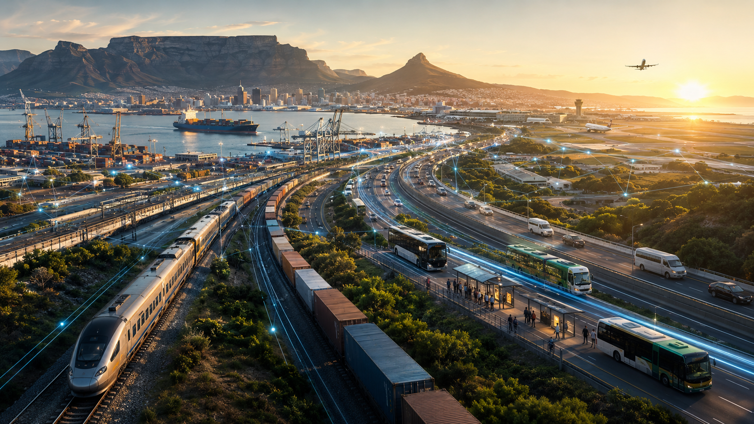
STRATEGIC CONCEPT NOTE
SOUTH AFRICA
TRANSPORT SECTOR
DIGITAL TRANSFORMATION
Building an integrated, intelligent and digitally enabled national transportation ecosystem
INITIAL STRATEGIC ENGAGEMENT
Prepared for the Department of Transport
Republic of South Africa
SPACHEE × ISIIVUNO
STN–SCN–001 | 2027–2035

Slide 2
01 / EXECUTIVE PROPOSITION
One country. One transport ecosystem. One trusted digital operating environment.
A national digital architecture that connects — rather than replaces — South Africa’s transport institutions, modes and existing systems.
01
CONNECT
02
ORCHESTRATE
03
INTELLIGENCE
04
TRANSFORM
People, operators, vehicles, infrastructure and freight
Road, rail, taxi, bus, ports, aviation and borders
Real-time visibility, predictive analytics and AI decision support
Safety, productivity, maintenance, mobility and logistics performance
The proposition is not a single IT project. It is a national transport transformation programme.
Digital infrastructure + data + AI + intelligent transport systems + automation + cybersecurity + interoperable platforms

Slide 3
02 / WHY NOW
South Africa is entering a structural transport reform window.
Rail recovery, open access, multimodal integration and logistics reform create a narrow opportunity to design the digital layer before the next infrastructure cycle hardens into new silos.
RECOVERY
PASSENGER RAIL
FREIGHT RAIL
PORTS
ROADS
100M+
600M
250M t
30 GCM/h
750,000 km
commuter rail journeys reached by end-March 2026
annual passenger rail ambition by 2030
freight rail ambition by 2030
port productivity benchmark
national road network scale
Digital transformation is the connective infrastructure that allows physical reform to operate as a system.
Sources: Department of Transport Strategic Plan 2025–2030; DoT Budget Vote 2025; DoT Roads Branch; Minister of Transport Africa Rail Convention, 8 Jul 2026.

Slide 4
03 / CURRENT-STATE DIAGNOSIS
The core constraint is fragmentation — not absence of technology.
Digital systems have evolved by mode, operator, institution, sphere of government and technology generation.
01
ROADS
02
PASSENGER RAIL
03
FREIGHT RAIL
04
TAXI
Separate data • separate workflows • limited cross-modal visibility
Separate data • separate workflows • limited cross-modal visibility
Separate data • separate workflows • limited cross-modal visibility
Separate data • separate workflows • limited cross-modal visibility
05
BUS / BRT
06
PORTS
07
AVIATION
08
BORDERS
Separate data • separate workflows • limited cross-modal visibility
Separate data • separate workflows • limited cross-modal visibility
Separate data • separate workflows • limited cross-modal visibility
Separate data • separate workflows • limited cross-modal visibility
Duplicated data → disconnected journeys → reactive operations → weak end-to-end visibility
THE OPPORTUNITY: build the interoperability layer between existing systems.

Slide 5

THE FUTURE STATE
FROM TRANSPORT INFRASTRUCTURE
TO A NATIONAL TRANSPORT OPERATING SYSTEM
TransportOS South Africa™ becomes the common digital backbone that links people, vehicles, infrastructure, freight, energy, payments, data and AI.
MOBILITY
ROADS
RAIL
LOGISTICS
PORTS
AVIATION
SAFETY
ENERGY
DATA + AI
ONE NATIONAL ARCHITECTURE • FEDERATED OPERATIONS • OPEN INTEROPERABILITY

Slide 6
04 / NATIONAL VISION
What changes when transport becomes digitally integrated?
The programme converts a large transport asset base into an observable, measurable, interoperable and increasingly predictive national system.
VISIBLE
MEASURABLE
INTEROPERABLE
Strategic passenger and freight movements become observable.
Common KPIs enable consistent national performance management.
Existing and future systems exchange trusted data through governed interfaces.
PREDICTIVE
INTELLIGENT
INVESTABLE
Maintenance, congestion, safety and demand move from reactive to forecast-driven.
AI supports optimisation, simulation and faster operational decisions.
Digital visibility improves project selection, asset utilisation and financing confidence.
Design principle: integrate before replacing.
Preserve statutory authority. Reuse functioning platforms. Standardise interfaces. Scale by outcomes.

Slide 7
05 / TARGET ARCHITECTURE
TransportOS South Africa™ — target digital architecture
A federated stack: existing systems remain authoritative while common integration, data, intelligence and security layers create national interoperability.
USERS + OPERATORS
Passengers • drivers • transport operators • freight owners • government • emergency services
DIGITAL SERVICES
Journey planning • payments • licensing • booking • freight visibility • traffic information • operator portals
TRANSPORTOS INTEGRATION
API gateway • event streaming • identity federation • GIS services • workflow • notifications • IoT management
DATA + INTELLIGENCE
Lakehouse • digital twin • operational analytics • AI • forecasting • simulation • predictive maintenance
OPERATIONAL SYSTEMS
Road ITS • public transport • eNaTIS interfaces • rail • port • airport • maritime • border • municipal systems
CONNECTIVITY + CYBER
Fibre • 4G/5G • private networks • satellite • edge • zero trust • SOC • DR/BCP
OPEN STANDARDS
MULTI-VENDOR
SOVEREIGN DATA
API-FIRST
SECURE BY DESIGN

Slide 8
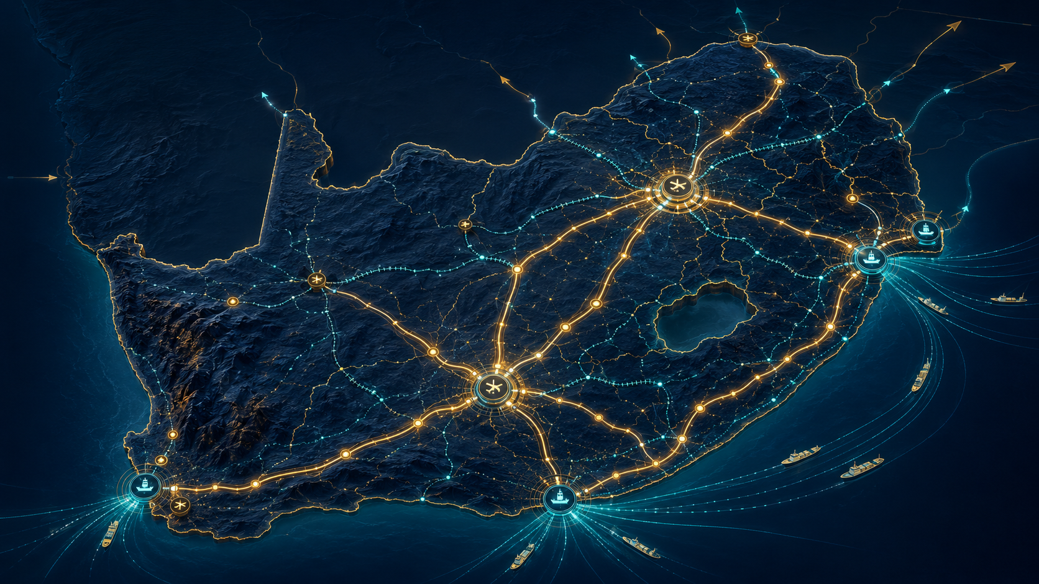
06 / NATIONAL TRANSPORT DIGITAL TWIN
One geospatial operating picture
of the national transport system.
01
ASSET IDENTITY
ownership • condition • lifecycle
02
LIVE OPERATIONS
Roads • bridges • rail • stations • taxi ranks • terminals • ports • airports • borders • charging • passenger flows • freight flows • incidents • asset condition • capital projects
traffic • trains • cargo • disruptions
03
PREDICTIVE LAYER
risk • demand • failure • capacity
04
PLANNING LAYER
scenario modelling • investment prioritisation
The digital twin is the spatial foundation for national transport planning, operations and investment decisions.

Slide 9
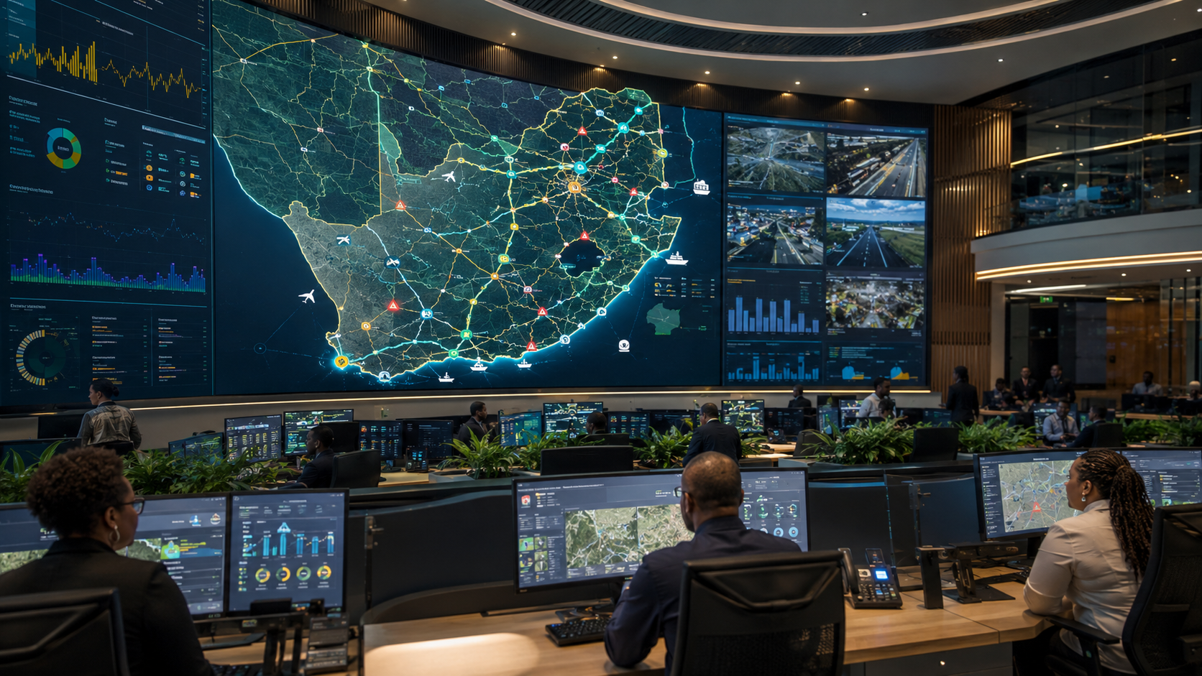
07 / NATIONAL TRANSPORT CONTROL TOWER
PASSENGERS
volumes • service disruptions • station congestion
From retrospective reporting
to real-time national transport management.
ROADS
congestion • incidents • works • heavy vehicles
RAIL
capacity • train movements • delays • infrastructure
The Control Tower federates entity-level control rooms; it does not duplicate them.
FREIGHT
cargo • ETA • terminals • borders
PORTS + AVIATION
vessels • terminals • air cargo • access
SAFETY + ASSETS
crashes • risk • condition • maintenance

Slide 10
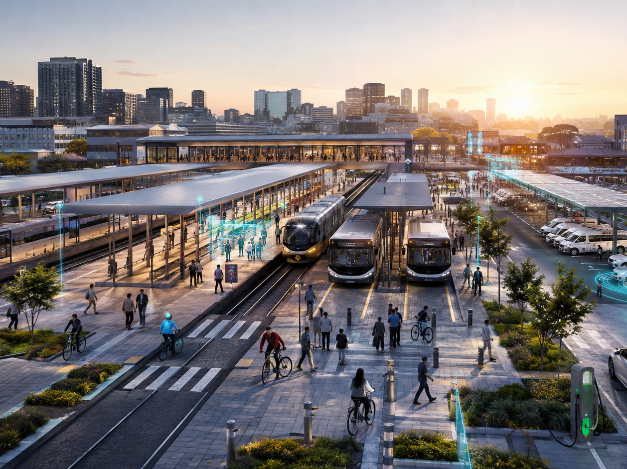
08 / PUBLIC MOBILITY
MobilityGrid™ — one passenger journey across multiple operators
Make rail, bus, BRT, minibus taxi, e-hailing and active mobility function as a coherent network from the passenger’s perspective.
1
HOME / ORIGIN
COMMON DIGITAL SERVICES
Journey planning
2
TAXI / E-HAIL
Real-time information
Mobility account
3
RAIL / BRT
Interoperable payment
Service alerts
4
BUS / WALK
Passenger feedback

Slide 11
09 / TAXI DIGITALISATION
Minibus taxi digital transformation — strengthen the backbone, do not displace it.
Digitise the operating environment around the sector while preserving its entrepreneurial model and commercial identity.
OPERATOR
onboarding + association
RANK
LICENCE
digital mobility hub
operating licence + route
DIGITAL
TAXI
ECOSYSTEM
ENERGY
VEHICLE
future EV charging
fleet + telematics
FINANCE
DRIVER
insurance + fleet renewal
identity + safety
PASSENGER
information + payment
Strategic result: formal digital participation + safer operations + better service + new finance and EV pathways.

Slide 12
10 / SMART ROADS
RoadGrid™ — turn passive road infrastructure into observable, intelligently managed assets.
Road digitalisation combines intelligent transport systems with lifecycle asset management and freight intelligence.
01
INTELLIGENT TRANSPORT
02
ASSET DIGITALISATION
03
FREIGHT + COMPLIANCE
04
RESILIENCE
adaptive signals
road inventory
weigh-in-motion
weather sensing
traffic management centres
pavement condition
heavy vehicle flows
flood alerts
incident detection
bridge condition
abnormal loads
work-zone management
variable messaging
inspection history
rest facilities
redundancy planning
smart intersections
predictive maintenance
corridor monitoring
emergency routing
Road scale: ~750,000 km nationally — digital prioritisation is essential to lifecycle economics.
Source: South Africa Department of Transport, Roads Branch.

Slide 13
11 / INTELLIGENT ROAD SAFETY
SafetyGrid™ — shift from reactive enforcement to predictive risk management.
A national Road Safety Intelligence Platform can combine crash, road, vehicle, driver, enforcement, weather and emergency information.
01
02
03
04
05
SENSE
UNDERSTAND
PREDICT
ACT
LEARN
crashes • speed • pedestrian exposure • vehicle condition
hotspots • behavioural patterns • infrastructure risk
high-risk corridors • dangerous intersections • fleet risk
targeted enforcement • engineering • emergency response
measure intervention outcomes • update risk models
National Road Safety Strategy direction: materially reduce fatalities by 2030 — digital intelligence becomes part of the safety system.
Source: Department of Transport / National Road Safety Strategy 2016–2030.

Slide 14
12 / RAIL DIGITAL TRANSFORMATION
RailGrid™ — digital coordination for a recovering passenger system and a multi-operator freight network.
Open access, new operators, restored corridors and ambitious 2030 targets increase the need for common digital coordination.
PASSENGER RAIL
FREIGHT RAIL
100M+
600M
250M t
OPEN
annual journeys by end-March 2026
annual ambition by 2030
annual freight ambition by 2030
multi-operator access environment
real-time passenger information
capacity + path visibility
automated fare collection
train planning + network status
station intelligence
operator + terminal interfaces
asset + rolling-stock monitoring
maintenance windows
security analytics
performance analytics
multimodal station integration
digital security
Sources: Minister of Transport Africa Rail Convention, 8 Jul 2026; Draft National Rail Master Plan consultation, 2026.

Slide 15
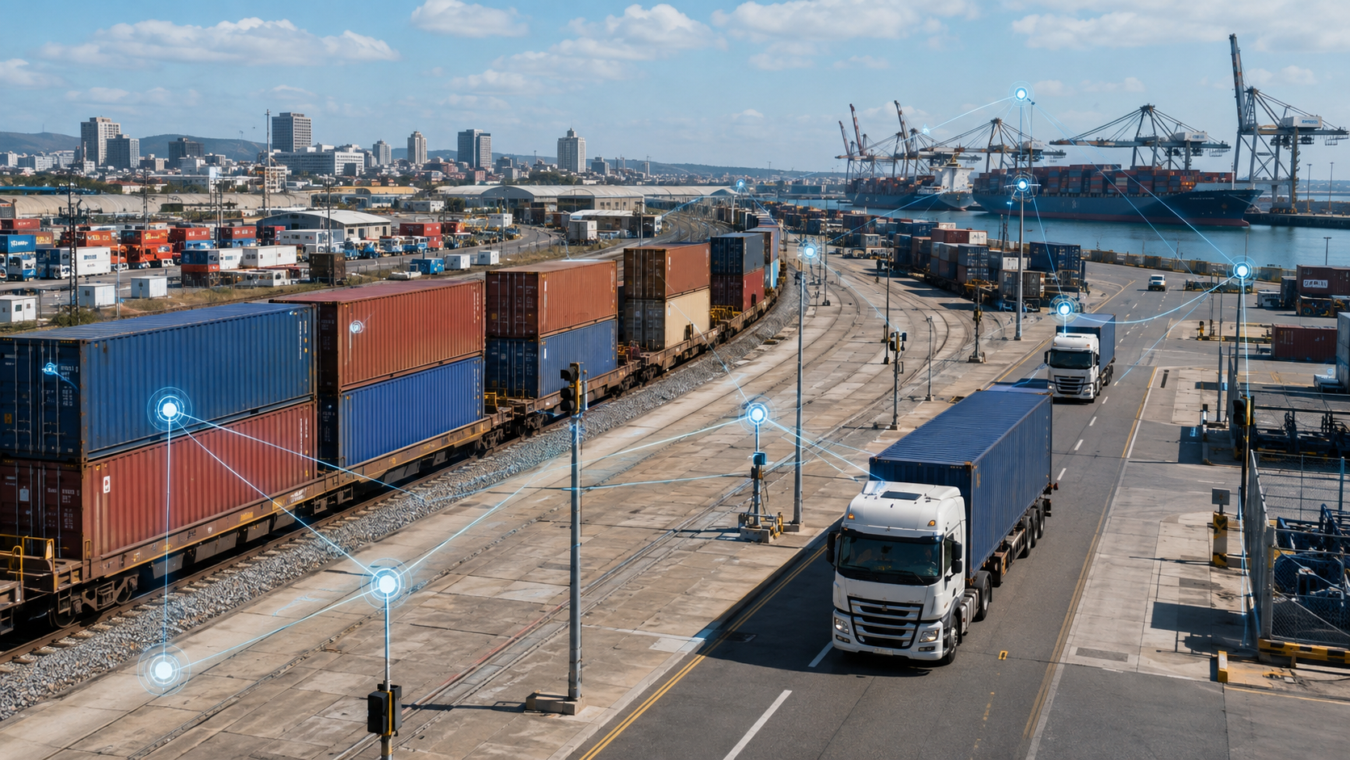
13 / LOGISTICSGRID™
Manage the complete cargo journey — not individual modes.
A common freight digital reference follows authorised cargo information across origin, truck, rail, inland terminal, port, airport and border.
FACTORY
TRUCK
INLAND TERMINAL
RAIL
PORT / AIRPORT
BORDER / VESSEL
Cargo visibility • ETA prediction • truck appointments • rail capacity • digital documents • exception management • corridor analytics

Slide 16
14 / PRIORITY CORRIDORS
Start with smart economic corridors — prove value, then scale nationally.
Corridor digital twins combine infrastructure, operators, freight flows, incident management and multimodal interfaces into one measurable operating environment.
01
GAUTENG ↔ DURBAN
Primary domestic logistics axis • road + rail + inland terminal + port
02
GAUTENG ↔ RICHARDS BAY
Bulk and industrial corridor • rail + road + port
03
GAUTENG ↔ MAPUTO / LEBOMBO
Regional trade corridor • road + rail + border
04
GAUTENG ↔ BEITBRIDGE
SADC road freight corridor • truck + border + customs
05
GAUTENG ↔ EASTERN CAPE
Automotive + container corridor • rail + road + manufacturing

Slide 17
15 / PORT + MARITIME
PortGrid™ — connect ports to the national logistics system.
Physical port reform should be matched by digital integration across vessel, terminal, rail, road, customs and cargo stakeholders.
VESSEL
arrival + berth
CARGO OWNER
TERMINAL
visibility + ETA
PORT
COMMUNITY
SYSTEM
yard + equipment
CUSTOMS
RAIL
documentation
train + slot
TRUCK
appointment + gate
Strategic metric: end-to-end cargo journey time — not just crane productivity.

Slide 18
16 / AVIATION
AviationGrid™ — connect airports, air cargo and surface mobility.
Digitalisation can make airports integrated national passenger and freight nodes rather than isolated aviation assets.
42M
01
PASSENGER FLOW
airport access • terminal analytics • disruption information
passengers through ACSA network policy target
02
AIR CARGO
1.2M t
cargo community systems • truck scheduling • visibility
03
AIRPORT DIGITAL TWIN
air-freight policy target
assets • energy • capacity • maintenance
04
SURFACE INTEGRATION
rail • bus • taxi • e-hailing • parking
05
SECURITY + RESILIENCE
operational continuity • cyber • incident coordination
Source: Department of Transport Budget Vote 2025/26 — policy-term aviation targets.

Slide 19
17 / CROSS-BORDER TRANSPORT
Smart borders — extend the transport system into SADC and AfCFTA trade corridors.
A truck should arrive at a border digitally prepared, with physical processing focused on identity, security and exceptions.
FREIGHT PRE-ARRIVAL
SINGLE-WINDOW INTERFACE
TRUCK ETA + QUEUE
ONE-STOP BORDER PROCESS
SMART
BORDER
NODE
OPERATOR VERIFICATION
CORRIDOR MONITORING
DIGITAL CARGO ID
EXCEPTION MANAGEMENT
South Africa’s future freight architecture is regional by default.

Slide 20
18 / CLEAN MOBILITY + ENERGY
EnergyGrid™ — transport digitalisation must anticipate electric mobility.
Charging, fleet operations and electricity planning increasingly become one system, particularly for high-utilisation public and commercial fleets.
01
02
03
04
05
VEHICLE
CHARGING
ENERGY
SOFTWARE
FINANCE
eBus • eTaxi • EV • eTruck
depot • rank • public • corridor
grid • solar • storage
smart charging • tariff • availability
fleet finance • battery / energy service
Priority principle: integrate energy planning first where vehicles have predictable duty cycles — depots, taxi ranks, bus fleets and freight hubs.

Slide 21
19 / AI-NATIVE OPERATIONS
DataGrid™ + AI — intelligence should be horizontal across every mode.
AI is not a standalone programme. It is the analytical layer that helps the transport system predict, optimise, detect and simulate.
PREDICT
OPTIMISE
DETECT
SIMULATE
demand • congestion • failure • delays • accident risk
signals • schedules • routing • fleet deployment • maintenance
incidents • intrusion • unsafe behaviour • fraud • equipment failure
new infrastructure • policy • disruptions • climate events • capacity
Human-authorised decisions
for consequential regulatory and enforcement actions.
Human-authorised decisions
for consequential regulatory and enforcement actions.
Human-authorised decisions
for consequential regulatory and enforcement actions.
Human-authorised decisions
for consequential regulatory and enforcement actions.
AI becomes valuable only when trusted, interoperable transport data exists.

Slide 22
20 / TRUST ARCHITECTURE
Digital sovereignty and cybersecurity are transport safety requirements.
Connected transport increases both capability and attack surface. Security therefore begins at architecture stage.
01
SOVEREIGN GOVERNANCE
South African law • institutional custodianship • data classification
02
ZERO TRUST
identity • least privilege • segmentation • encryption
03
SECURITY OPERATIONS
SOC • SIEM • threat intelligence • incident response
04
OT + IT RESILIENCE
road control • signalling • port • airport • continuity
05
AUDIT + AI GOVERNANCE
traceability • human oversight • model governance
The objective is secure, controlled interoperability — not uncontrolled data centralisation.

Slide 23
21 / PROGRAMME STRUCTURE
A national programme delivered as modular workstreams under one controlled architecture.
Shared platforms are centralised; modal and field packages remain modular. This controls complexity and procurement risk.
01
02
03
04
COMMON NATIONAL PLATFORMS
MODAL DIGITAL PROGRAMMES
FIELD INFRASTRUCTURE
ENABLING PROGRAMMES
TransportOS
Road
Sensors
Data governance
Data Exchange
Public Mobility
Cameras
Skills + localisation
Digital Twin
Taxi
Connectivity
Change
Control Tower
Rail
Edge
Benefits realisation
Cybersecurity
Freight
Control rooms
PMO + assurance
Port
Depot / station systems
Aviation
Maritime
ONE architecture • MANY implementation packages • COMMON standards • MEASURABLE benefits

Slide 24
22 / PRIORITY PILOTS
12–24 month early-win portfolio
Prioritise use cases that create visible operating value while establishing the national digital foundation.
01
National Transport Executive Dashboard
02
National Freight Corridor Dashboard
03
Road Safety Intelligence Platform
04
Priority Road Digital Twin
federated cross-modal performance view
real-time corridor visibility
predictive risk + intervention prioritisation
asset condition + maintenance intelligence
05
Gauteng–Durban Cargo Visibility
06
Public Transport Journey Planner
07
Taxi Route + Rank Digitalisation
08
Rail Network Performance Integration
end-to-end multimodal freight tracking
common passenger information layer
foundation for sector-scale integration
network + infrastructure intelligence
Selection test: national relevance × measurable benefit × data readiness × implementation speed × scalability

Slide 25
23 / DELIVERY ROADMAP
A phased development path — prove, scale, then automate.
The programme should be gated so the Department can validate value, architecture and institutional readiness before committing to national scale.
GATE 0
PHASE I
PHASE II
PHASE III
PHASE IV
PROGRAMME DEVELOPMENT
DIGITAL FOUNDATION
CORRIDORS + METROS
NATIONAL SCALE
AI-NATIVE OPERATIONS
2026/27
2027–2028
2028–2030
2030–2032
2032–2035
current state • target architecture • feasibility • financing • pilots • decision package
TransportOS • Data Exchange • Digital Twin v1 • cyber foundation • priority integrations
priority freight corridors • mobility integration • taxi pilots • smart roads • rail digital services
provinces • major metros • ports • airports • rail • strategic borders
predictive maintenance • dynamic optimisation • advanced connected infrastructure

Slide 26
24 / GOVERNANCE
Government-led architecture. Federated operations. Clear accountability.
The Department remains policy authority, programme sponsor, standards authority, benefits owner and national architecture custodian.
DEPARTMENT OF TRANSPORT — PROGRAMME SPONSOR + ARCHITECTURE AUTHORITY
01
NATIONAL STEERING COMMITTEE
02
PROGRAMME MANAGEMENT OFFICE
03
ARCHITECTURE + DATA + CYBER COUNCILS
policy • entities • Treasury • provinces
scope • schedule • finance • risk • procurement
standards • data • security • assurance
04
MODAL WORKSTREAMS
05
PROVINCES + METROS
06
BENEFITS REALISATION OFFICE
road • rail • public transport • freight • ports • aviation
local operations • integration • public transport
outcome tracking • value assurance • KPI governance

Slide 27
25 / PROPOSED PARTNER ROLE
Spachee × Isiivuno — proposed programme development and transformation partners.
The initial role is to help the Department convert the strategic opportunity into a validated national programme — without predetermining procurement outcomes.
SPACHEE
ISIIVUNO
Strategic programme development
Institutional transformation
Digital + enterprise architecture
South African localisation
Data / AI / cybersecurity architecture
Stakeholder mobilisation
Technology strategy + systems integration
Workforce + change management
Feasibility + commercial structuring
Benefits realisation
Programme management architecture
Local supplier + skills development
Open standards • Department-led requirements • multi-vendor technology ecosystem

Slide 28
26 / COMMERCIAL + FUNDING PRINCIPLE
Funding architecture — mobilise private capital around public strategic control.
The feasibility phase should separate public-good national digital infrastructure from commercially financeable services and field investments.
01
02
03
04
PUBLIC
DFI / BLENDED
PPP / PRIVATE
COMMERCIAL
appropriations • entity CAPEX • infrastructure programmes
DBSA • development finance • climate / green finance
concessions • availability models • private participation
payments • parking • charging • fleet services • platform services
Immediate engagement does not seek capital approval, contract award, exclusivity or government guarantee.
It seeks permission to develop a bankable, phased and institutionally aligned programme.

Slide 29
27 / PROPOSED DEVELOPMENT PHASE
The immediate next step is programme development — not implementation.
A controlled feasibility and architecture phase establishes evidence, priorities, technical design, institutional ownership and financing before any major procurement decision.
01
CURRENT STATE
02
REQUIREMENTS
03
TARGET ARCHITECTURE
systems • assets • projects • data • connectivity • maturity
Department • entities • passenger • freight • regulatory
enterprise • data • cyber • command • integration
04
PRIORITY USE CASES
05
ECONOMIC + FINANCIAL
06
IMPLEMENTATION
value • readiness • pilot selection • corridors
costs • benefits • funding • PPP / private capital
governance • packaging • procurement • roadmap • decision gates
OUTPUT: Departmental decision package for progression, redesign or stop.

Slide 30
28 / INITIAL ENGAGEMENT ASK
What Spachee × Isiivuno are requesting from the Department
A low-risk first decision: strategic alignment and authority to develop the proposition properly.
01
STRATEGIC PRESENTATION
Engage Department leadership on the national digital transformation opportunity.
02
DEPARTMENTAL GUIDANCE
Align the concept to existing programmes, policy priorities and institutional realities.
03
FOCAL POINTS
Identify appropriate branches and officials for structured programme development.
04
DISCOVERY ACCESS
Enable controlled engagements with designated entities and stakeholders.
05
FEASIBILITY IN PRINCIPLE
Agree a pathway to formal feasibility, architecture and implementation planning.

Slide 31
29 / GOVERNANCE SAFEGUARD
The initial engagement is deliberately non-procurement.
This framing protects the Department, the programme and future competition while enabling serious programme development.
×
Technology contract
×
Commitment to a specific vendor
×
Unsolicited award
×
Immediate capital approval
×
Exclusivity
×
Government guarantee
×
Displacement of existing programmes
×
Bypassing Treasury / procurement requirements
The purpose is to establish whether sufficient strategic merit exists to develop the programme jointly and formally.

Slide 32
THE NORTH STAR
TRANSPORTOS
SOUTH AFRICA™
The digital operating environment for the national transport economy.
INTEGRATED TRANSPORT
DIGITAL INFRASTRUCTURE
NATIONAL INTELLIGENCE
ECONOMIC COMPETITIVENESS
SPACHEE × ISIIVUNO
Initial strategic engagement with the Department of Transport
Republic of South Africa
INTEGRATED. INTELLIGENT. SAFE. COMPETITIVE.

Slide 33
30 / REFERENCES
Source base and strategic references
Selected public-sector sources used to anchor the strategic context and policy targets in this presentation.
01
Department of Transport
Strategic Plan 2025–2030
Integrated transport mandate, innovation, multimodal planning and sector outcomes.
02
Department of Transport
Annual Performance Plan 2026/27
Current programme priorities and implementation context.
03
Minister of Transport
Budget Vote 2025/26
Rail, port and aviation policy-term targets.
04
Department of Transport / Cabinet
Draft National Rail Master Plan, 2026
Long-term passenger and freight rail modernisation framework.
05
Minister of Transport
Africa Rail Convention, 8 July 2026
100M+ passenger journeys, 600M ambition, freight rail reform and 250Mt ambition.
06
Department of Transport
Roads Branch
Approx. 750,000 km national road-network scale.
07
Department of Transport / RTMC
National Road Safety Strategy 2016–2030
National road-safety direction and 2030 fatality-reduction objective.
Presentation prepared as a strategic concept proposition. Detailed technical, legal, financial and procurement design remains subject to Department-led feasibility and applicable approvals.

